Slide 1

kailāsaḥ कैलासः
हरि ॐ
Sudhanva Manjunath Athreya
Abhay Pratap Singh
Guided by : Dr Nimrita Koul &
Shri P V S Kumar

Slide 2
Kailāsaḥ
About Kailāsaḥ
कैलासः तन्त्रांशसाधनं शब्दं विभज्य सन्धिर्नाम लिखति।
Kailāsaḥ is a website That performs the sandhi Vibhajana and determines the sandhi.

Slide 3
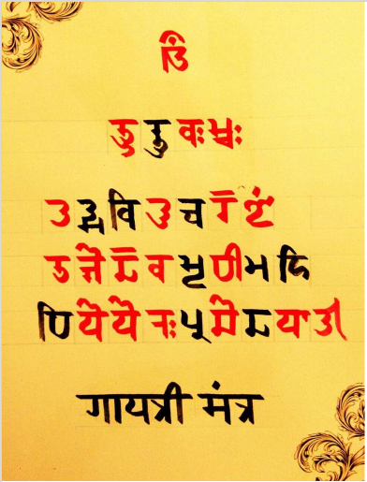
Background
Devī Gāyatrī mantra

Slide 4

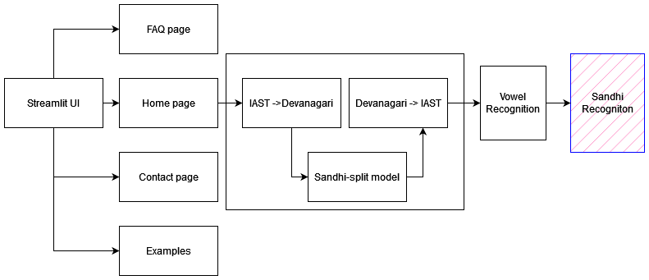
Pipeline

Slide 5

Transliteration & Word split
Provided Devanagari text is converted to IAST
2018emnlp model is being used & it requires IAST to perform sandhi split
Utility for Harvard-Kyoto , ITRANS , SLP1 texts is provided and can be utilized as per the model
Entire unit can be replaced to use a different model.
Currently we’re targeting for svara sandhi.
Current model : https://github.com/OliverHellwig/sanskrit/tree/master/papers/2018emnlp
IAST : International Alphabet of Sanskrit Transliteration

Slide 6
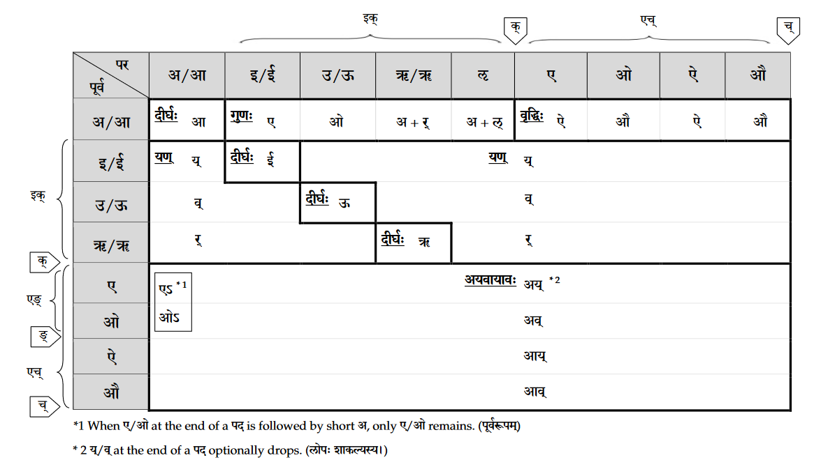
Vowel Recognition
Methodology
Last vowel of the first word is extracted
First vowel of the second word is extracted

Slide 7
In Comparison with existing tools
Tool Name
Tool Methodology
JNU Tools
UoH Sandhi Tools
Using a dictionary of possible morphemes, this tool, at every location recursively checks for binary splits.
Recursively breaks a word at every possible position and applies appropriate Sandhi rules to generate possible morpheme candidates

Slide 8

Image SLide
Key points to be noted
IAST to Devanagari script achieved time complexity of O(log(n)) compared to the available tools with O(n) time complexity
OliverHellwig state-of-the-art model performs vibhajana

Slide 9
Image SLide
Discussion

Slide 10



THANK YOU
Reva
University
Sudhanva Manjunath Athreya
+91 9108171918
sudhava0asvl@outlook.com
https://sud0x00.github.io/
In work is supported by the Department of Science and Technology(DST), Government of India under the project grant DST/TDT/SHRi-14/2021(C).

